Slide 1
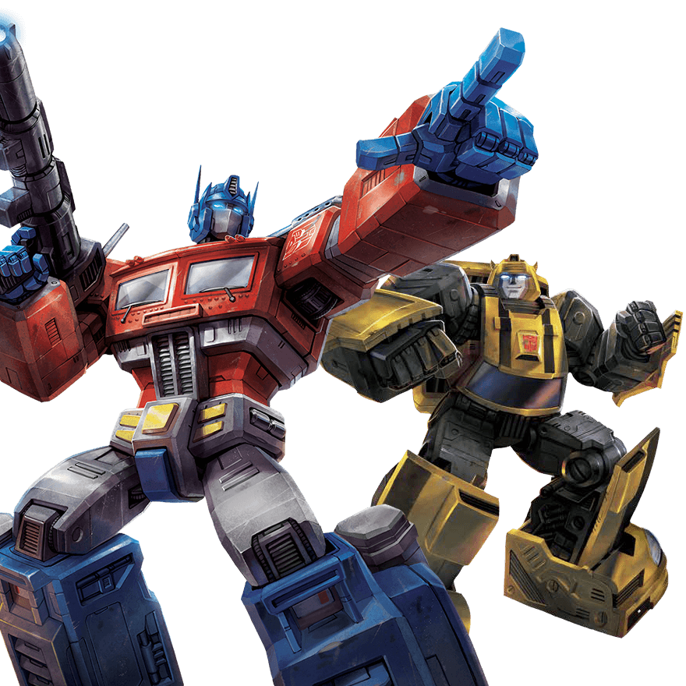
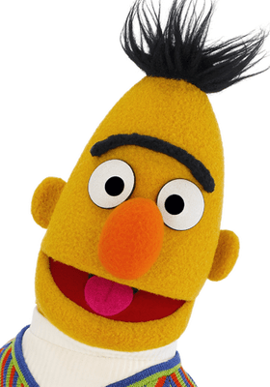
Transformer
BERT
李宏毅
Hung-yi Lee

Slide 2
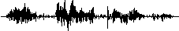
Sequence-to-sequence (Seq2seq)
Input a sequence, output a sequence
The output length is determined by model.
Speech
Recognition
你
好
嗎
N
T
機
器
學
習
Machine
Translation
machine
learning
N
N’
machine
learning
機
器
學
習
Speech
Translation
Language without text
Notes:
Transformer 是一个 Sequence-to-sequence (Seq2seq) model
Speech Recognition 语音识别
Speech Translation 语音翻译
Speech Recognition + Machine Translation
Why don’t we simply concatenate two system?

Slide 3


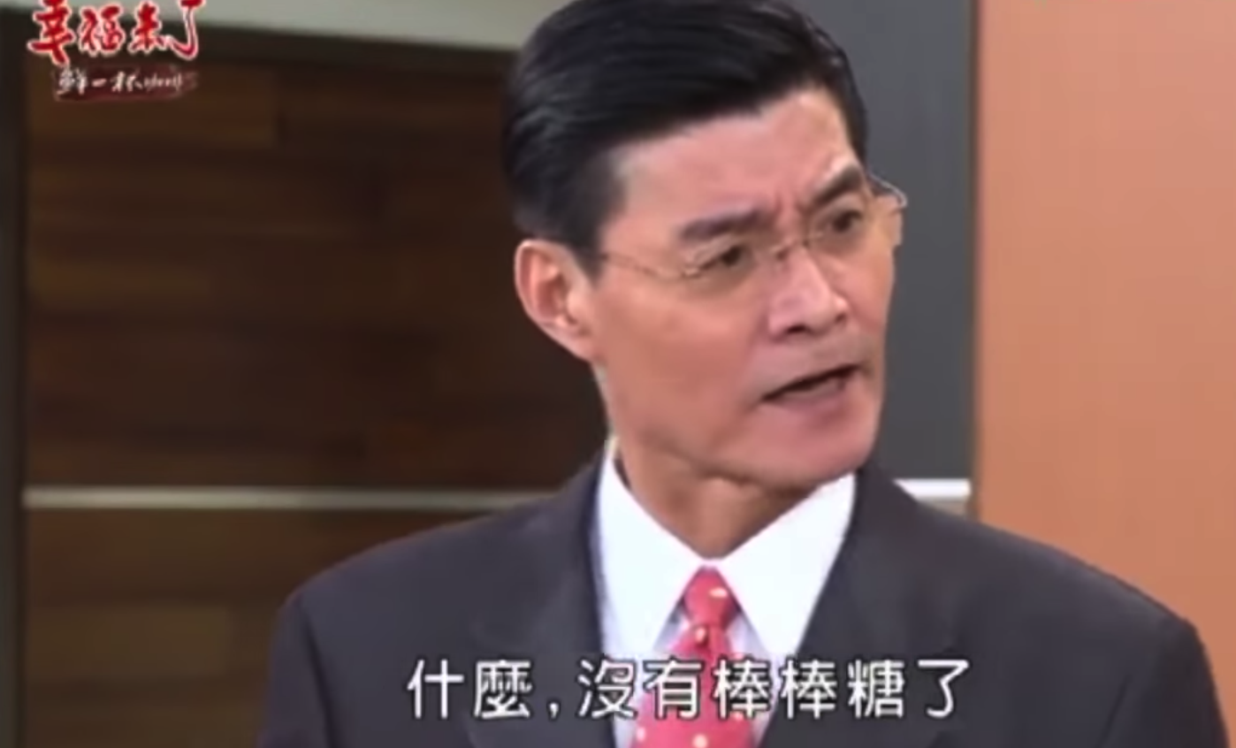
Hokkien (閩南語、台語)
Speech Recognition
“母湯”
??????? …
(Speech of Hokkien)
Speech
Translation
“不行”
(Speech of Hokkien)
Local soap operas (鄉土劇) on YouTube (Speech of Hokkien, Chinese subtitle)
Using 1500 hours of data for training
Notes:
Speech Recognition 语音识别
Speech Translation 语音翻译
Speech Recognition + Machine Translation
Why don’t we simply concatenate two system?

Slide 4
Hokkien (閩南語、台語)
Background music & noises?
Noisy transcriptions?
Phonemes of Hokkien?
Don’t care …
Don’t care …
No ……
“硬train一發”
(Ying Train Yi Fa)
Notes:
https://ieeexplore.ieee.org/document/8682801/ (ICASSP 2019)

Slide 5

Hokkien (閩南語、台語)
感謝 李仲翊 同學提供實驗結果
你 的 身 體 撐 不 住
沒 事 你 為 什 麼 要 請 假
要 生 了 嗎
Answer:不 會 膩 嗎
我 有 幫 廠 長 拜 託
Answer: 我 拜 託 廠 長 了
To learn more: https://sites.google.com/speech.ntut.edu.tw/fsw/home/challenge-2020
Notes:
https://ieeexplore.ieee.org/document/8682801/ (ICASSP 2019)

Slide 6
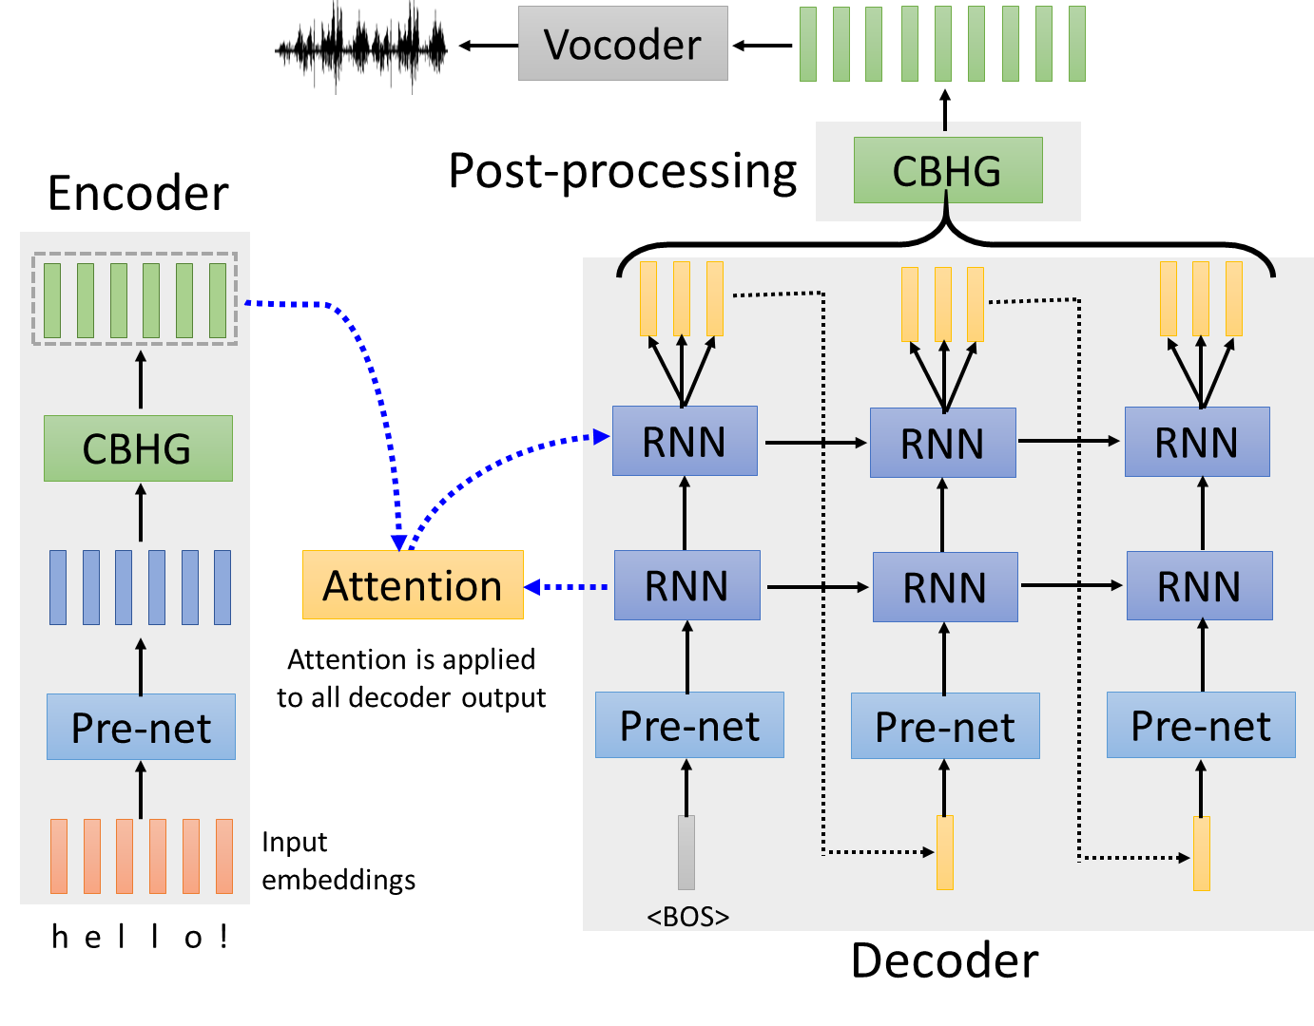
Text-to-Speech (TTS) Synthesis
感謝張凱為同學提供實驗結果
Taiwanese Speech Synthesis
Source of data: 台灣媠聲2.0
歡迎來到台大語音處理實驗室
最近肺炎真嚴重，要記得戴口罩、勤洗手，有病就要看醫生
Notes:
Text-to-Speech (TTS) Synthesis 文本转语音 (TTS) 合成

Slide 7
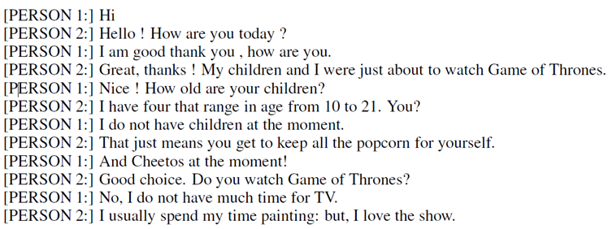
Seq2seq for Chatbot
“Hello! How are you today?”
seq2seq
input
response
“Hi”
Training
data:
Notes:
https://youtu.be/mk6v2raVGfk

Slide 8
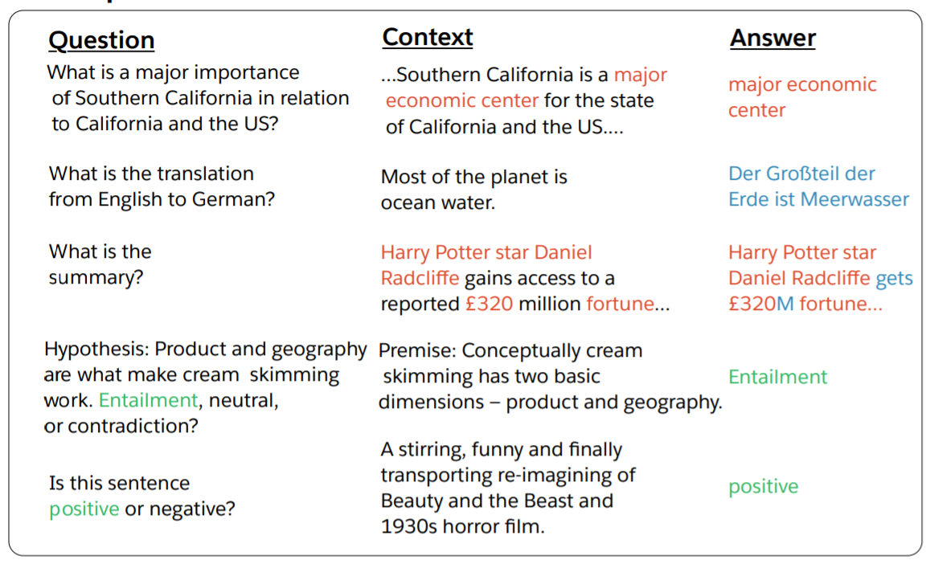

Most Natural Language Processing applications …
Question Answering (QA)
(sentiment analysis)
QA can be done by seq2seq
Seq2seq
question, context
answer
https://arxiv.org/abs/1806.08730
https://arxiv.org/abs/1909.03329
Notes:
各式各样的 NLP 的问题都可以看作是 QA 的问题，例如
机器翻译，给机器读一篇中文文章，问机器这边文章的英文翻译是什么
摘要，给机器读一篇文章，问机器这边文章的摘要是什么
sentiment analysis 情绪分析

Slide 9
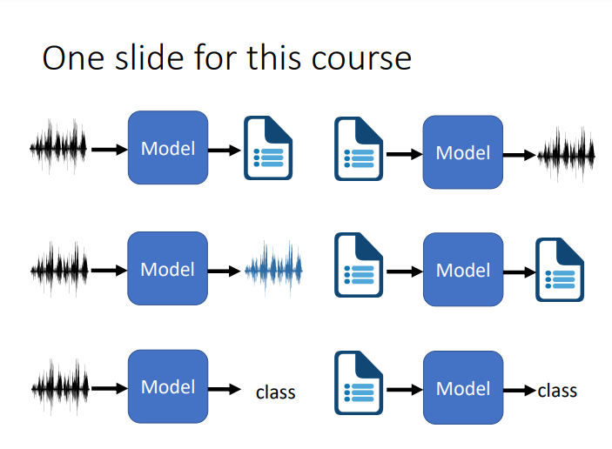
Deep Learning for Human Language Processing
深度學習與人類語言處理
Source webpage: https://speech.ee.ntu.edu.tw/~hylee/dlhlp/2020-spring.html

Slide 10
Seq2seq for Syntactic Parsing
Is it a sequence?
S
Model
Output
VP
NP
ADJV
Model
Input
deep learning is very powerful
Notes:
Oriol Vinyals
https://arxiv.org/abs/1412.7449
Of course, you can try other tree traversal approaches
state-of-the-art results …

Slide 11
Seq2seq for Syntactic Parsing
(S
(NP
deep
learning
)
(VP
is
(ADJV
very
powerful
)
)
)
Seq2seq!
S
VP
NP
ADJV
deep learning is very powerful
Notes:
Oriol Vinyals
https://arxiv.org/abs/1412.7449
Of course, you can try other tree traversal approaches
state-of-the-art results …

Slide 12
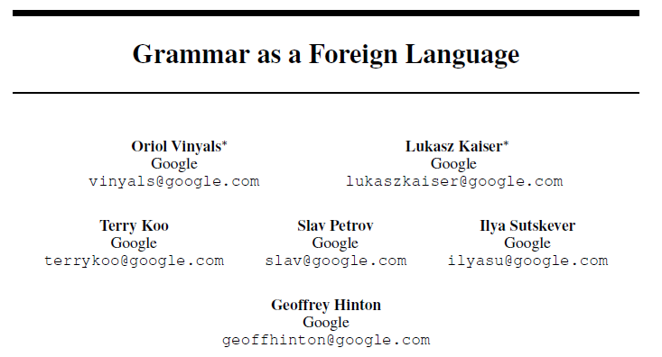
Seq2seq for Syntactic Parsing
(S
(NP
deep
learning
)
(VP
is
(ADJV
very
powerful
)
)
)
https://arxiv.org/abs/1412.7449
deep learning is very powerful
Notes:
Oriol Vinyals
https://arxiv.org/abs/1412.7449
Of course, you can try other tree traversal approaches
state-of-the-art results …

Slide 13

Seq2seq for Multi-label Classification
c.f. Multi-class Classification
An object can belong to multiple classes.
Class 1
Class 1
Class 3
Class 10
Class 3
Class 9
Class 17
Seq2seq
Class 9
Class 7
Class 13
https://arxiv.org/abs/1909.03434
https://arxiv.org/abs/1707.05495
Notes:
Multi-class Classification 与 Multi-label Classification 是不同的
Multi-class Classification 只输出一个分类
Multi-label Classification 需要输出多个分类
能不能使用 Multi-class Classification 输出前 N 个 概率最大的分类处理 Multi-label Classification 的问题
不行，因为 Multi-label Classification 输出几个分类是由机器决定的，不能固定输出 N 个分类

Slide 14
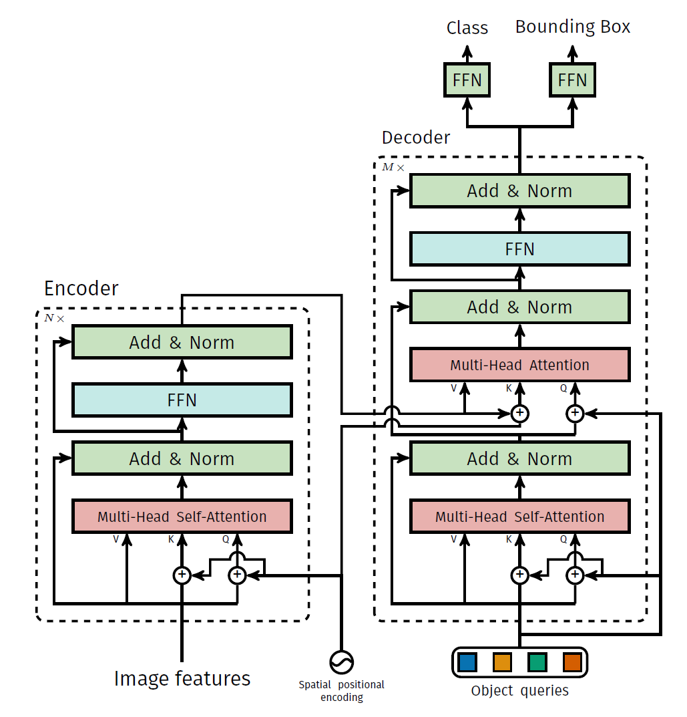
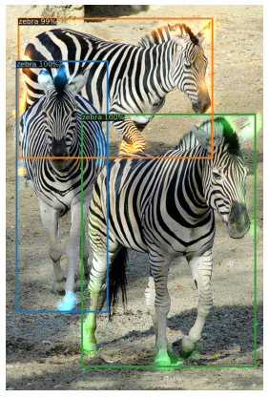
Seq2seq for Object Detection
https://arxiv.org/abs/2005.12872
Notes:
Object Detection 物体检测

Slide 15
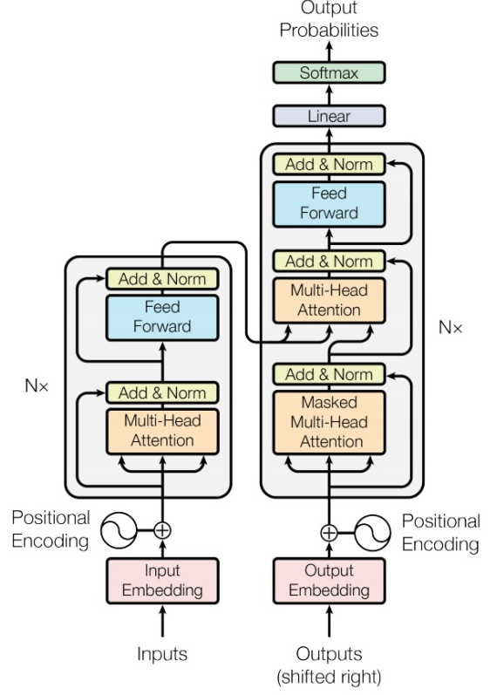

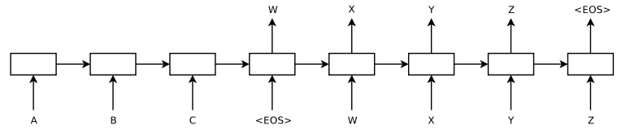
Seq2seq
output sequence
Encoder
Decoder
Input sequence
Sequence to Sequence Learning with Neural Networks
Transformer
https://arxiv.org/abs/1409.3215
https://arxiv.org/abs/1706.03762

Slide 16
Encoder
output sequence
Encoder
Decoder
Input sequence

Slide 17
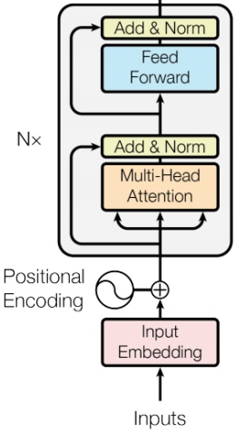
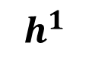
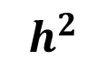
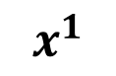
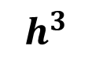
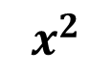
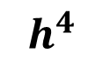
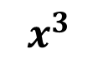
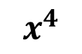
Encoder
Transformer’s Encoder
You can use RNN or CNN.
$$h^{1}$$
$$h^{2}$$
$$h^{3}$$
$$h^{4}$$
Encoder
$$x^{1}$$
$$x^{2}$$
$$x^{3}$$
$$x^{4}$$
Notes:
可以用 CNN, RNN
不用拘泥於 Transformer’s Encoder

Slide 18
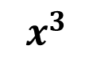
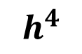
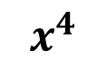
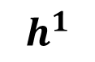
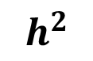
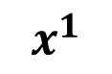
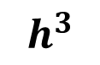
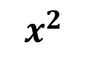
$$h^{1}$$
$$h^{2}$$
$$h^{3}$$
$$h^{4}$$
Block
…
…
…
…
FC
FC
FC
FC
Block
Block
Self-attention
$$x^{1}$$
$$x^{2}$$
$$x^{3}$$
$$x^{4}$$

Slide 19

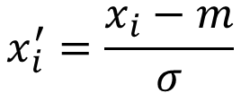
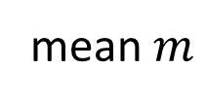
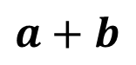
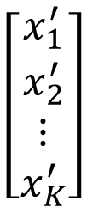
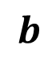
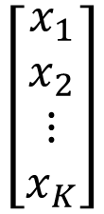
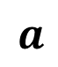
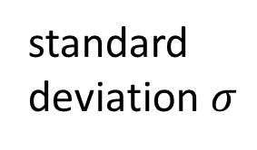
…
$$\left[\begin{aligned}x_{1}^{′} \\ x_{2}^{′} \\ ⋮ \\ x_{K}^{′}\end{aligned}\right]$$
$$x_{i}^{′}=\frac{x_{i}−m}{σ}$$
norm
Layer Norm
norm
norm
https://arxiv.org/abs/1607.06450
+
residual
$$a+b$$
$$\left[\begin{aligned}x_{1} \\ x_{2} \\ ⋮ \\ x_{K}\end{aligned}\right]$$
mean $m$
FC
standard deviation $σ$
$$b$$
+
$$a$$
Self-attention

Slide 20
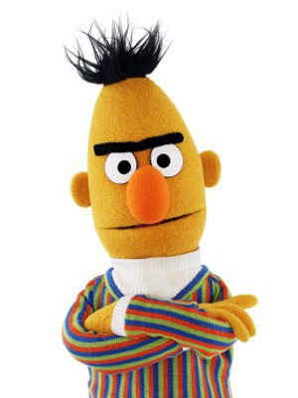
BERT
I use the same network architecture as transformer encoder.
$$h^{1}$$
$$h^{2}$$
$$h^{3}$$
$$h^{4}$$
Encoder
Residual
+ Layer norm
$$x^{1}$$
$$x^{2}$$
$$x^{3}$$
$$x^{4}$$

Slide 21
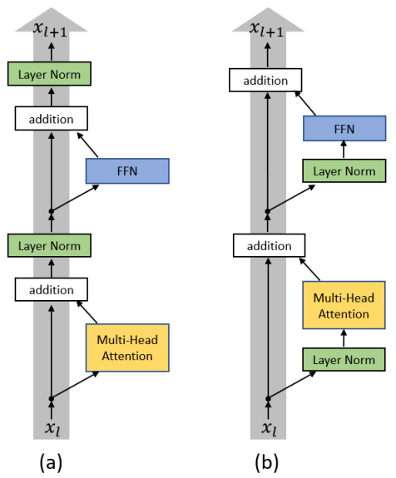
To learn more ……
On Layer Normalization in the Transformer Architecture
https://arxiv.org/abs/2002.04745
PowerNorm: Rethinking Batch Normalization in Transformers
https://arxiv.org/abs/2003.07845
Notes:
Why not BN?
https://arxiv.org/pdf/2003.07845.pdf
=======
This is about initialization
https://arxiv.org/pdf/1908.11365.pdf

Slide 22
Decoder
output sequence
Encoder
Decoder
Input sequence

Slide 23
Decoder – Autoregressive (AT)
output sequence
Encoder
Decoder
Input sequence
Notes:
Decoder 有两种
1、Autoregressive (AT) 自回归 (AT)
2、Non-autoregressive (NAT)

Slide 24
Autoregressive
distribution
(Speech Recognition as example)
學 | 0.0
機 | 0.8
器 | 0.0
習 | 0.1
…… | ……
機
Size V
max
(common characters)
softmax
Encoder
Decoder
( 機器學習 )
(special token)
START
Notes:
What is BOS?
Should I talk about sampling???
(special token)
begin of sentence
vocabulary 词汇
如果输出中文，vocabulary size 就是常见中文的数量

Slide 25
Autoregressive
機
器
學
習
max
max
max
max
Encoder
Decoder
( 機器學習 )
START
機
器
學

Slide 26
Autoregressive
氣
機
器
學
習
max
Encoder
Decoder
Decoder
Output
( 機器學習 )
START
器
學
機
氣
Notes:
如果 decoder 其中一个输出错误怎么办
会有一步错，步步错的问题
也就是 error propagation 问题
error propagation 错误传播

Slide 27
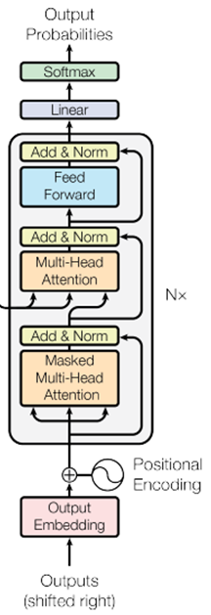
ignore the input from the encoder here ☺
機
器
學
習
max
max
max
max
Decoder
START
機
器
學
Notes:
What is BOS?

Slide 28
Encoder
Decoder

Slide 29
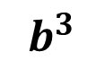
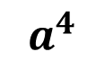
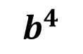
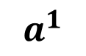
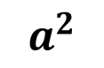
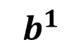
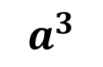
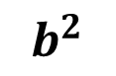
Self-attention
Masked Self-attention
$$b^{1}$$
$$b^{2}$$
$$b^{3}$$
$$b^{4}$$
$$a^{1}$$
$$a^{2}$$
$$a^{3}$$
$$a^{4}$$
Can be either input or a hidden layer
Notes:
什么是 masked
Masked: attend on the generated sequence
Self-attention -> Masked Self-attention
Masked Self-attention 本质就是只考虑左边的输入

Slide 30
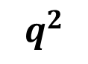
















Self-attention
Masked Self-attention
$$b^{2}$$
$$α_{2,1}^{′}$$
$$α_{2,2}^{′}$$
$$α_{2,3}^{′}$$
$$α_{2,4}^{′}$$
$$q^{1}$$
$$k^{1}$$
$$v^{1}$$
$$q^{2}$$
$$k^{2}$$
$$v^{2}$$
$$q^{3}$$
$$k^{3}$$
$$v^{3}$$
$$q^{4}$$
$$k^{4}$$
$$v^{4}$$
$$a^{1}$$
$$a^{2}$$
$$a^{3}$$
$$a^{4}$$
Consider how does decoder work
Why masked?

Slide 31
Autoregressive
We do not know the correct output length.
Never stop!
機
器
學
習
慣
……
max
max
max
max
max
Encoder
Decoder
( 機器學習 )
START
機
器
學
習
Notes:
Decoder 什么时候停止输出

Slide 32

推文接龍 (Tweet Solitaire)
推 tlkagk: =========斷==========

Slide 33
distribution
Adding “Stop Token”
學 | 0.0
機 | 0.8
器 | 0.0
習 | 0.1
…… | ……
END | 0.0
Size V
(common characters)
softmax
Encoder
Decoder
( 機器學習 )
START

Slide 34
Autoregressive
Stop at here!
機
器
學
習
END
max
max
max
max
max
Encoder
Decoder
( 機器學習 )
START
機
器
學
習

Slide 35
Decoder – Non-autoregressive (NAT)
output sequence
Encoder
Decoder
Input sequence
Notes:
Decoder 有两种
1、Autoregressive (AT) 自回归 (AT)
2、Non-autoregressive (NAT)

Slide 36

AT v.s. NAT
w₁
w₃
w₁
END
w₂
END
w₂
w₃
w₄
AT Decoder
NAT Decoder
START
w₁
w₂
w₃
START
START
START
START
How to decide the output length for NAT decoder?
Another predictor for output length
Output a very long sequence, ignore tokens after END
Advantage: parallel, more stable generation (e.g., TTS)
(why? Multi-modality)
NAT is usually worse than AT

Slide 37

To learn more ……
https://youtu.be/jvyKmU4OM3c
(in Mandarin)

Slide 38
Encoder-Decoder
output sequence
Encoder
Decoder
Input sequence

Slide 39

Transformer
Cross attention
Notes:
I need to know consider which layer?

Slide 40














FC
$$v$$
$$α_{1}^{′}$$
$$α_{2}^{′}$$
$$α_{3}^{′}$$
Cross attention
$$k^{1}$$
$$v^{1}$$
$$k^{2}$$
$$v^{2}$$
$$k^{3}$$
$$v^{3}$$
$$q$$
$$a^{1}$$
$$a^{2}$$
$$a^{3}$$
Encoder
Self-attention (Mask)
START
Notes:
Cross attention 交叉注意力

Slide 41


FC
$$v′$$
$$α_{1}^{′}$$
$$α_{2}^{′}$$
$$α_{3}^{′}$$
$$k^{1}$$
$$v^{1}$$
$$k^{2}$$
$$v^{2}$$
$$k^{3}$$
$$v^{3}$$
$$q′$$
$$a^{1}$$
$$a^{2}$$
$$a^{3}$$
Encoder
Self-attention (Mask)
START
機

Slide 42

Cross Attention
Listen, attend and spell: A neural network for large vocabulary conversational speech recognition
https://ieeexplore.ieee.org/document/7472621
(This is not transformer.)

Slide 43


Cross Attention
Source of image:
https://arxiv.org/abs/2005.08081

Slide 44
Training
output sequence
Encoder
Decoder
Input sequence

Slide 45
學 | 0
機 | 1
器 | 0
鬼 | 0
…… | ……
Ground truth
distribution
機
學 | 0.1
機 | 0.7
器 | 0.1
鬼 | 0.1
…… | ……
Size V
minimize cross entropy
(common characters)
softmax
Encoder
Decoder
Label: 機 器 學 習
<BOS>

Slide 46
Teacher Forcing: using the ground truth as input.
機
器
學
習
<EOS>
minimize cross entropy
Encoder
Decoder
Ground Truth
Label: 機 器 學 習
<BOS>
機
器
學
習
Notes:
Teacher Forcing: using the ground truth as input.
训练的时候，强行给 decoder 输入正确答案
预测的时候，decoder 的输入是 decoder 的上一个输出

Slide 47
Tips
output sequence
Encoder
Decoder
Input sequence

Slide 48
Copy Mechanism
Machine Translation
Chat-bot
User: X寶你好，我是庫洛洛
Machine:庫洛洛你好，很高興認識你
Notes:
Copy Mechanism 复制机制
有些任务的输出内容包含输入的内容，比如聊天机器人
这时直接复制输入内容即可

Slide 49

Copy Mechanism
https://arxiv.org/abs/1704.04368
Summarization

Slide 50

Copy Mechanism
Pointer Network
https://youtu.be/VdOyqNQ9aww
Incorporating Copying Mechanism in Sequence-to-Sequence Learning
https://arxiv.org/abs/1603.06393

Slide 51
Guided Attention
高雄發大財我現在要出征
發財發財發財發財
發財發財發財
發財發財
發財
(Missing an input character!)
Notes:
Guided Attention 引导注意力

Slide 52
























Guided Attention
Monotonic Attention
Location-aware attention
In some tasks, input and output are monotonically aligned. For example, speech recognition, TTS, etc.
Attention weights
$$a^{1}$$
$$a^{2}$$
$$a^{3}$$
$$a^{4}$$
$$a^{1}$$
$$a^{2}$$
$$a^{3}$$
$$a^{4}$$
$$a^{1}$$
$$a^{2}$$
$$a^{3}$$
$$a^{4}$$
generate the 1st output
generate the 2nd output
generate the 3rd output
$$a^{1}$$
$$a^{2}$$
$$a^{3}$$
$$a^{4}$$
$$a^{1}$$
$$a^{2}$$
$$a^{3}$$
$$a^{4}$$
$$a^{1}$$
$$a^{2}$$
$$a^{3}$$
$$a^{4}$$
generate the 1st output
generate the 2nd output
Generate the 3rd output
Something wrong!
Notes:
Guided Attention 引导注意力
In some tasks, input and output are monotonically aligned. For example, speech recognition, TTS, etc. 在某些任务中，输入和输出是单调对齐的。例如语音识别、TTS 等。
Monotonic Attention 单调注意力
Location-aware attention 位置感知注意力

Slide 53

Beam Search
The red path is Greedy Decoding.
The green path is the best one.
Not possible to check all the paths …
$→$ Beam Search
A
B
A
B
A
A
B
B
0.4
0.6
0.9
0.4
A
B
0.6
A
B
0.9
0.6
A
B
0.4
Assume there are only two tokens (V=2).

Slide 54

Sampling
The Curious Case of Neural Text Degeneration
https://arxiv.org/abs/1904.09751
Randomness is needed for decoder when generating sequence in some tasks.
Accept that nothing is perfect. True beauty lies in the cracks of imperfection. ☺
Notes:
寄生蟲的故事?

Slide 55
Optimizing Evaluation Metrics?
機
器
學
習
<EOS>
機
器
學
習
<EOS>
BLEU score?
Decoder
Decoder
How to do the optimization?
When you don’t know how to optimize, just use reinforcement learning (RL)!
https://arxiv.org/abs/1511.06732

Slide 56
There is a mismatch! ☹
exposure bias
機
器
學
機
氣
學
Decoder
Decoder
START
機
氣
<BOS>
器
機
氣
Ground Truth
Notes:
Exposure 曝光
如果 decoder 其中一个输出错误怎么办
会有一步错，步步错的问题
也就是 error propagation 问题
error propagation 错误传播
怎么解决 error propagation 的问题
很简单，就是在训练数据中也给出一些错误的数据
这种方法就是 Scheduled Sampling

Slide 57


Scheduled Sampling
Original Scheduled Sampling
Scheduled Sampling for Transformer
Parallel Scheduled Sampling
https://arxiv.org/abs/1506.03099
https://arxiv.org/abs/1906.07651
https://arxiv.org/abs/1906.04331
Notes:
Exposure 曝光
如果 decoder 其中一个输出错误怎么办
会有一步错，步步错的问题
也就是 error propagation 问题
error propagation 错误传播
怎么解决 error propagation 的问题
很简单，就是在训练数据中也给出一些错误的数据
这种方法就是 Scheduled Sampling

Slide 58
Concluding Remarks:
Transformer

Slide 59


